Slide 1
Symphonic Music (Symphony)

Slide 2
To begin…
When people talk about “symphony”, what do they really mean?
Orchestra?
Symphonic Orchestra?
Philharmonic?

Slide 3
Here are the strict definitions:
Symphony: an extended work for orchestra. (It is the preeminent GENRE of orchestral music since the mid-18th century. )
Orchestra: a large group of instrumentalists. (It can be used in ANY music genre!)

Slide 4
Here are the strict definitions:
Symphonic Orchestra: an orchestra that has both the number of players and types of instruments required to play a symphony.
Philharmonic: a word simply means “music-loving”. It is often used to differentiate between two orchestras in the same city, e.g. the Toronto Symphony Orchestra and the Toronto Philharmonic Orchestra. (Yes! That’s it!)

Slide 5
Other possible sources of confusion
Orchestra can also refer to a particular spot in the theater where musicians perform on stage. E.g., the “orchestra level seating”.
A symphony orchestra sometimes just called “a symphony” for short.
Therefore, just to clarify, the symphonic music we are talking about today, AKA symphony, refers to the Musical Genre symphony exclusively.

Slide 6
So here we go again......
Sample facts & musical terms you need to know about symphony
Real concert experience: Stage layout, conductor, and concert program (program notes)
The development of symphonic music from 17th to 20th century
The content of this lecture:

Slide 7
Sample facts & musical terms you need to know about symphony
For Musical Form: A symphony is a large-scale musical composition, usually consisting of multiple distinct sections or movements, often four, with the first movement in sonata form.
Movement in music means a unit of a larger work that may stand by itself as a complete composition.（like a chapter of a book!)
But what is sonata form ? That is a bit more complicated.......

Slide 8
Sonata Form
(AKA sonata-allegro form or first movement form)
A musical structure consisting of three main sections: an exposition (A section), a development (a contrasting section with A, B section), and a recapitulation ( basically a repetition of the first section).
In short, we can simplify the sonata form as an ABA form.
The musical theme A (a remarkable melody at the beginning of the music) contrasts with section B and eventually comes back to itself at the end of the movement.

Slide 9
Sonata Form cont.
Here are two short demo videos that try to make this dry concept more approachable :D
https://youtu.be/2G6xMcUUbEA?t=32
https://www.youtube.com/watch?v=L7PfGTtUC84

Slide 10
Now For the Real concert experience... ...
The size of orchestra:
Symphonies are almost always scored for an orchestra consisting of a string section (violin, viola, cello, and double bass), brass, woodwind, and percussion instruments which altogether number about 30 to100 musicians.

Slide 11
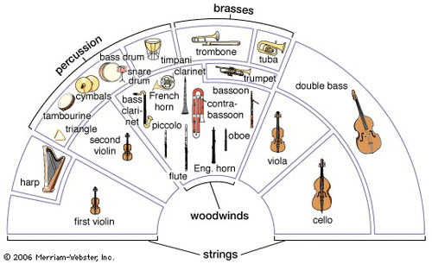
The layout of a symphony orchestra

Slide 12
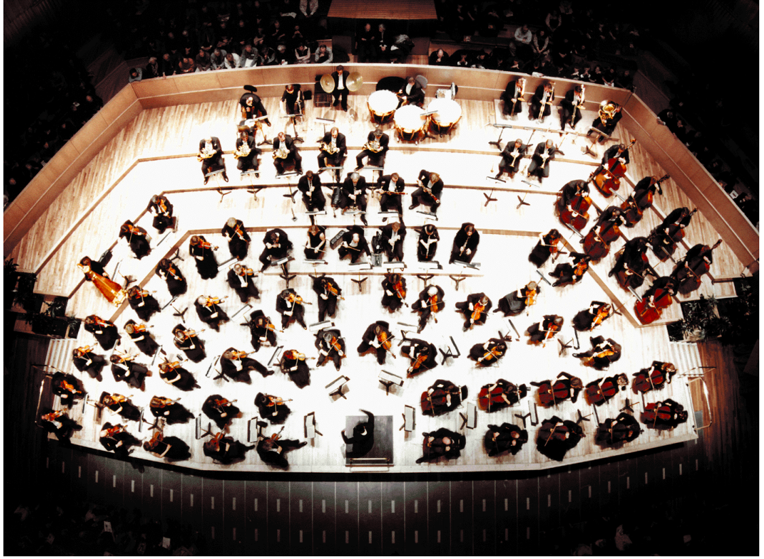
The layout of a symphony orchestra

Slide 13
The conductor
What does the conductor do on the stage and why is he/she important?
The primary responsibilities of the conductor are to unify performers, set the tempo, execute clear preparations and beats, listen critically and shape the sound of the ensemble, and to control the interpretation and pacing of the music.

Slide 14
A Brief Review
Symphony’s advantage in which elements of music make it becomes the preeminent genre of orchestral music? (please name at least 3 elements)
How many elements of music are controlled by the conductor during a symphonic orchestra concert? (please name at least 3 elements)

Slide 15
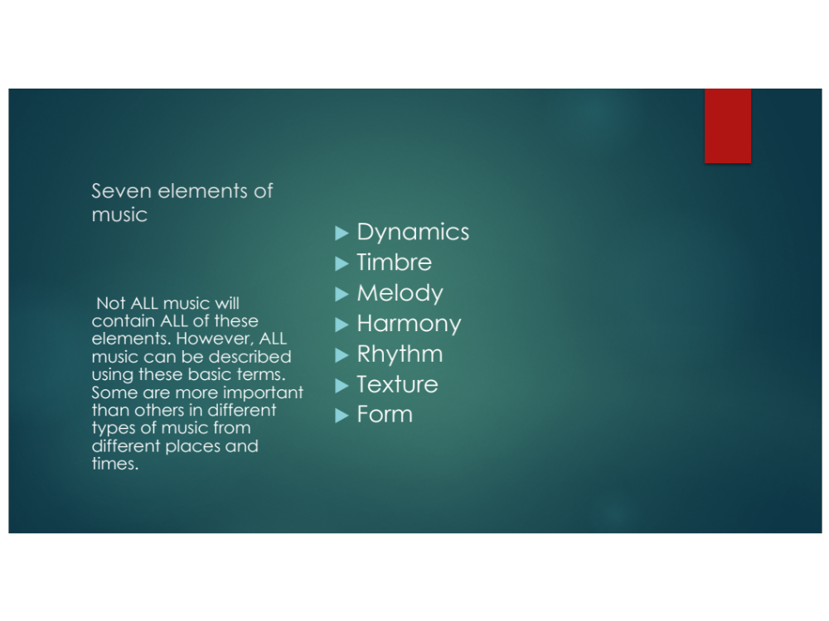

Slide 16
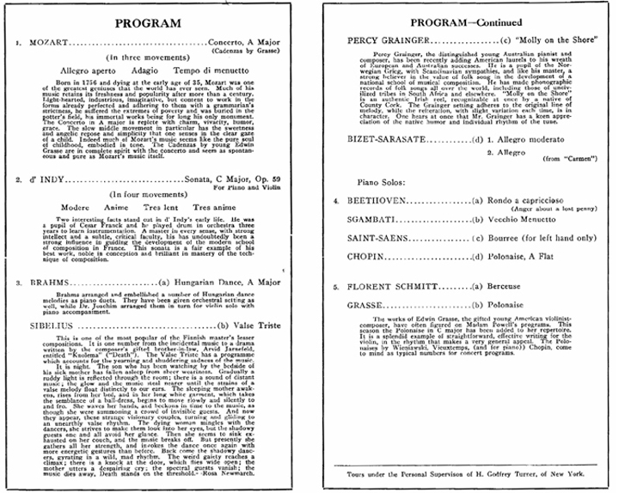
The concert program
Concert program(program notes) serve two purposes: to provide historical and background information on the piece and the composer; and to give the audience some sense of what to expect, and what to listen for, when listening to the work.

Slide 17
And Here is one more thing... ...
please don’t clap between movements!!! 😄 😄 😄 😄 😄 😄 😄 😄 😄 😄 😄 😄 😄 😄

Slide 18
The common-practice period of classical music:
In the history of European art music, the common practice period is the era of the tonal system. The period saw considerable stylistic evolution, with some patterns and conventions flourishing and then declining, for example, the sonata form.

Slide 19
The common-practice period period of classical music:
The Baroque period (1600-1750)
The Classical period (1770-1820)
The Romantic period (1810-1910)

Slide 20
The historical development of the symphony
17th century symphonic music: the origin of the genre
‘Symphony’ or ‘sinfonia’ was applied to introductory movements to operas, oratorios, and cantatas. In general, it was an instrumental introduction of a larger framework.

Slide 21
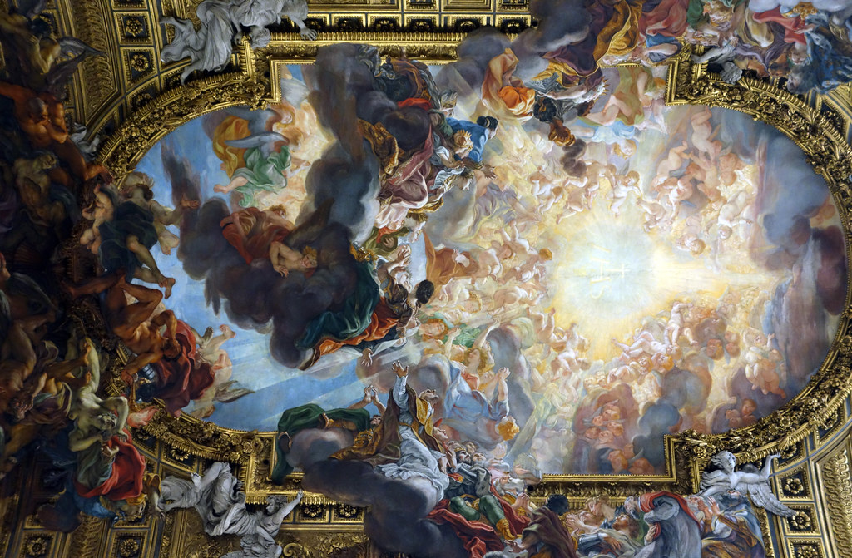
The historical development of the symphony
The Sinfonia (Overture). From G. F. Handel’s Messiah. (Baroque-era oratorio)
https://youtu.be/ZobP0Ym8Lqs

Slide 22
The historical development of the symphony cont.
18th century symphonic music: the establishment of classical style
The leading area of symphonic production was Vienna and the rest of the Habsburg Monarchy, followed by Germany, Italy, France and England.

Slide 23
The social function of 18th century’s symphony
Symphonies provided an important element of state, civic and institutional functions, including:
Official ceremonies
Banquets
Private concerts in palaces
Catholic church services

Slide 24
An interesting (sad) fact of the time:
in 1799, the Duchess of Brunswick insisted that the orchestra always play softly so the card-playing should not be disturbed.
😂

Slide 25
Leading composers of the18th century symphonic music:
C.P.E Bach (son of the Great J.S. Bach)
Joseph Haydn
Wolfgang Amadeus Mozart

Slide 26
The Instrumentation of 18th century symphony
The earliest concert symphonies : For string alone, with the accompany of harpsichord and Bassoon.
E.g., C. P. E. Bach - Symphony in G major, Wq 182,1 https://youtu.be/3WJlQC3ytMA?t=19

Slide 27
The Instrumentation of 18th century symphony
For standard symphonic orchestra from 1740 to around 1770s: strings (4 parts), horns, oboes, and some other instruments such as trumpet, flute, and clarinets
E.g., Haydn Symphony No. 7 in C major, “Le midi” (The Noon). ( The piece is scored for 2 flutes, 2 oboes, bassoon, 2 horns, strings and continuo.)
https://youtu.be/N74IQ65-TOE?t=6

Slide 28
Let us learn more about 18th century composers
Joseph Haydn (1732-1809) was an Austrian composer of the Classical period.
He was recruited as a choir boy and received voice and keyboard training when he was very young.
After getting dismissed from choir, he became a student of Italian composer Nicola Porpora (1686-1768), then hired by Esterhazy court for the rest of his career (30 years!).

Slide 29
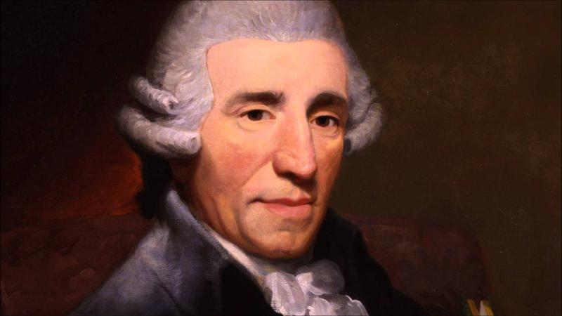
late in life he made trips to London, where he received great success for his compositions.
Haydn wrote 107 symphonies in total, as well as 83 string quartets, 45 piano trios, 62 piano sonatas, 14 masses and 26 operas, amongst countless other scores.

Slide 30
A Fun Document : Haydn’s Employment Contract from the Archives of the Esterházy Court
He will be received and treated as a house staff member.
When the orchestra is called upon to perform, he needs to appear in uniform.
He will bound to compose such music as his Serene Highness shall command, and he shall not compose for any other person.
He will daily appear both morning and afternoon at the princely antechamber to inquire whether his Highness wishes a concert be given.

Slide 31
A Fun Document :Haydn’s Employment Contract from the Archives of the Esterházy Court, cont.
He should take charge of all musical activities and all musical instruments, and be responsible for maintenance as well.
If any dispute or cause for complaint arise among the musicians, he will try to resolve such matters so his Serene Highness will not be disturbed.
He will instruct the female singers.
he should keep up his skill in all the instruments in which he is proficient.

Slide 32
The style of Haydn’s symphonic music:
Haydn extended the development section and made it encompasses materials from both the exposition and recapitulation. Therefore, the recapitulation was recomposed rather than merely restarting the material of the exposition. These ideas exercised a major influence on Beethoven.
Haydn wrote three “times of day” symphonies in 1761 (No. 6, “Le Matin,” No. 7, “Le Midi,” and No. 8, “Le Soir”). All of these symphonies have solo passages for winds and strings.

Slide 33
The style of Haydn’s symphonic music cont.
His famous dynamic surprises was also appropriated by Beethoven. (e.g. the ff tutti entrance in the slow movement of the ‘Surprise Symphony, no.94, https://youtu.be/gbf1LVE4UKM?t=506 ),
Haydn wrote a larger proportion of work in minor keys than most 18th century symphonists.

Slide 34
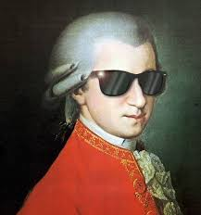
Let us learn more about 18th century composers
Austrian composer Wolfgang Amadeus Mozart (1756-1791) was the leading figure of the Viennese Classical school, and one of the greatest composers in the history of western music. He composed over 600 works include more than 50 symphonies.

Slide 35
The style of Mozart’s symphonic music:
Mozart applied rich chordal vocabulary and far-ranging modulations.
In development section, Mozart enjoyed having his established theme travel through different harmonic territory, to maintain the interest of his audience.

Slide 36
The style of Mozart’s symphonic music cont.
Mozart remained good symmetry in his symphonies. The sound quality between his phrases and musical characters are usually well balanced.
Now let’s hear a segment from Mozart’s symphony No. 40 in G minor, K. 550 ☺ https://youtu.be/JTc1mDieQI8?t=3

Slide 37
The historical development of the symphony cont.
19th century symphonic music: the essence of the genre
In this period, composers consistently designated as a symphony work for a medium or large-sized orchestra, usually consisting of three, four, or five movements (most commonly four).

Slide 38
The social function of 19th century’s symphony
the symphony was understood to represent the emotions or ideas of the entire community, or the whole of humanity. This perception of the symphony as an expression of the communal sentiment grew throughout the 19th century.

Slide 39
The Instrumentation of 19th century symphony
By the end of the century, the norm for a large orchestra had grown to triple woodwind (with third players doubling on an additional instrument) and up to 20 brass instruments, in addition to an ever-increasing number of string.

Slide 40
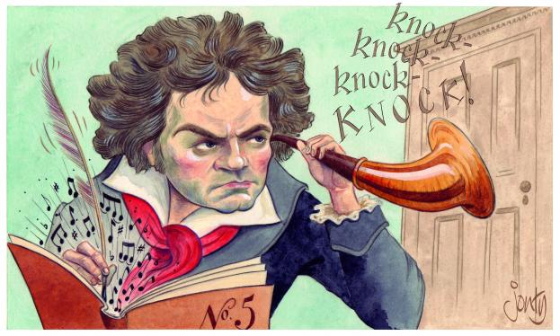
Let us learn more about 19th century composers
Beethoven! Beethoven! Beethoven himself!
( Then everyone else who lived in the shadow of the toooooo great Beethoven)!

Slide 41
Ludwig van Beethoven (1770-1827) is considered one of the greatest classical composers who has ever lived. He moved to Vienna, Austria from his home in Germany in 1792 and lived there for the rest of his life.
Although Beethoven suffered intensely from hearing loss, he wrote some of the best-known symphonies of all time.

Slide 42
The style of Beethoven’s symphonic music:
------ A man ahead of his time
Beethoven’s innovations in formal design/technique development are so consistently extraordinary, that it is impossible to single out any one of his symphonies as ‘typical’.

Slide 43
The style of Beethoven’s symphonic music:
Beethoven explored a variety of ways for instrumental music to evoke images and ideas transcending the world of sound. ( like his fifth symphony ‘Fate’, Beethoven’s symphonies have programmatic titles or movement headings, pointed the way all the more openly towards such extra-musical interpretations).

Slide 44
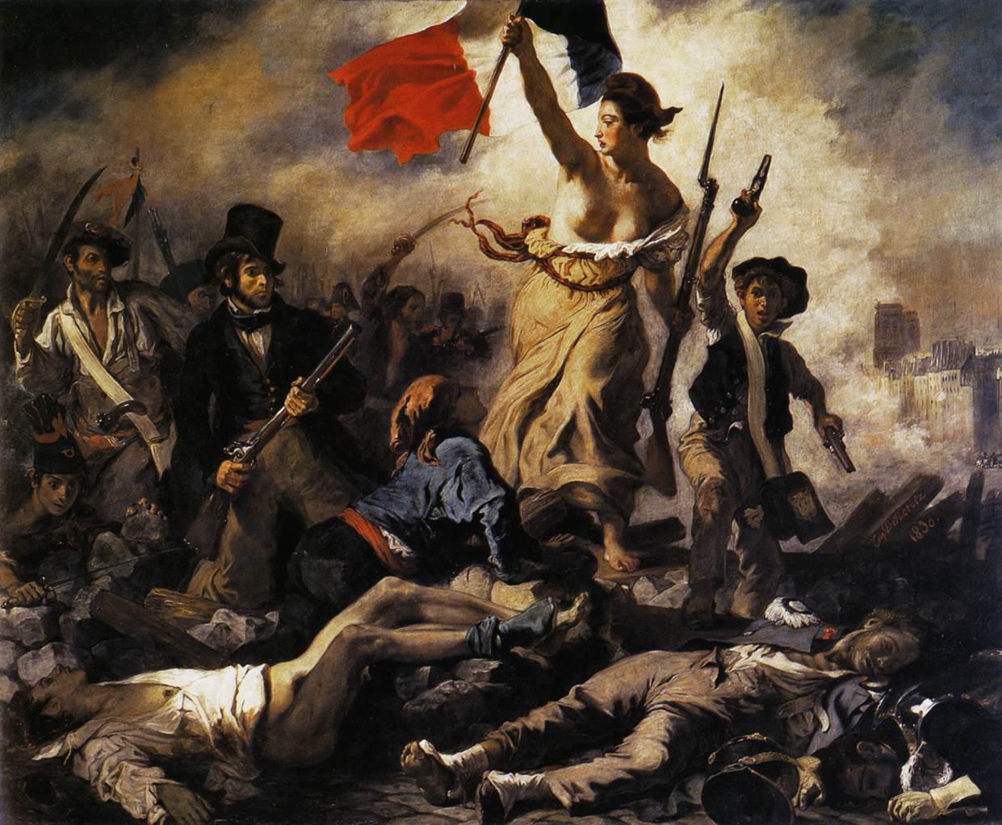
Now let’s hear a segment from Beethoven’s ninth symphony, Movement IV – “Ode to Joy” https://youtu.be/uooe16ILaPo

Slide 45
The historical development of the symphony
20th century symphonic music: the fullest maturity and its end.
Generally speaking, due to the hostile political climate, advances in technology, and huge shifts in style, music in the 20th century changed dramatically. The massive use of nontraditional harmony led to a constant re-evaluation of the sonata form, and hence of the symphony as a whole.

Slide 46
The form of symphony become flexible. (Symphonic poem and Single-movement symphony)
The instrumentation of symphony become flexible. (E.g., Stravinsky’s symphonies of wind instruments)
The raising of anti-Romantic and atonal symphonies. (ex. Sibelius’ third and fourth symphony)

Slide 47
Therefore, the definition of symphonic music itself becomes ambiguous again.

Slide 48
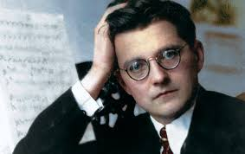
Let us learn more about 20th century composer
Dmitri Shostakovich (1906-1975) was one of the greatest twentieth-century composers.
Born and raised in St. Petersburg, Russia, he studied at St. Petersburg Conservatory in the aftermath of World War I and the 1917 Russian Revolution.
His compositions include 15 symphonies, numerous chamber works, and concertos.

Slide 49
The style of Shostakovich’s symphonic music:
Shostakovich struggled between his personal introspection and pessimism, and the Soviet official cultural dogma of clarity, simplicity, and optimism (e.g., his symphony No.2 and No.3).
Shostakovich’s symphonies were heavily influenced by the post-Romanticism associated with Gustav Mahler.
Shostakovich’s style features sharp contrasts, grotesque elements, and ambivalent tonality.

Slide 50
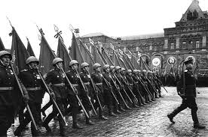
Now let’s hear a segment from Shostakovich’s ninth symphony, Movement V, Allegretto-Allegro https://youtu.be/AfakIg9E_ao?t=1278

Slide 51
When you analyze a piece of music, don’t forget to consider the society and situation that composer lived in, please ask yourself:

Slide 52
What does it mean to be a composer at Haydn, Mozart, Beethoven, and Shostakovich’s time, respectively ?
What period of the composer’s career (earlier/middle/late) that the piece of music belongs to?
How does a composer’s personal style influence his/her music?

Slide 53
Haydn Symphony No. 7 in C major, “Le midi” (The Noon)
For background information:
Year of the piece? (1761)
Where was the composer ? (Esterhazy court)
What was the purpose of this piece?(dedicate to his employer)
In which period of his compositional life? (the composer was 29 years old, this is one of his early works)

Slide 54
Haydn Symphony No. 7 in C major, “Le midi” (The Noon)
For musical information:
How many movements? (see concert program)
What is the tempo of each movement ?（Ibid.）
What is the instrumentation of the symphony?（Ibid.）
What is the musical character of each movement ? （Listening to the music, combine your subjective feeling with all above information.)

Slide 55
And here is another approach you may consider: The comparative study
Hint : The well-known American conductor and Leonard Bernstein once said, Shostakovich‘s 9th Symphony was the lightest of the composer’s fifteen symphonies and also the most “Haydnesque” one.

Slide 56
Italian musical terms for tempo markings
Grave — slow and solemn
Lento — slowly
Largo — broadly
Adagio — slow and stately (literally, "at ease")
Andante — at a walking pace
Moderato — moderately
Allegretto — moderately fast (but less so than allegro)
Allegro — fast, quickly and bright
Vivace — lively and fast (quicker than allegro)

Slide 57
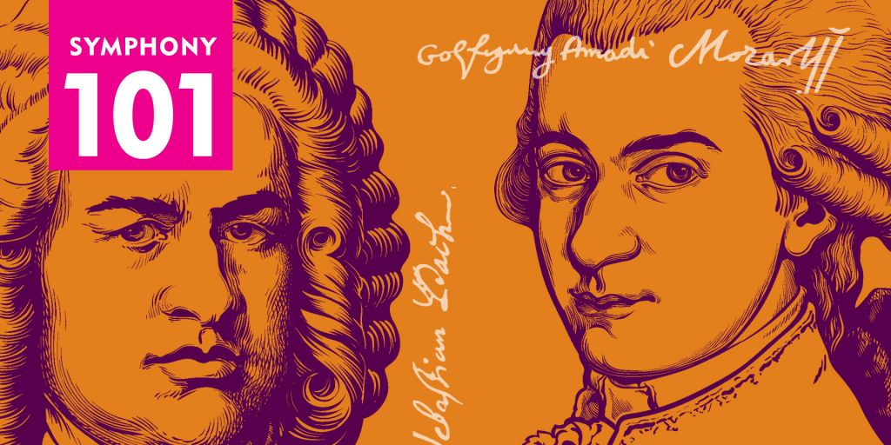
The End

